Slide 1
Georgia Tech Facilities INC.
Introduction to Using a Purchase Order for Construction Contracting

Slide 2
What is a purchase order at GT?
How do I use a purchase order?
How do I issue a change order against purchase order?

Slide 3
Purchase Orders at GT.
Contracts are publicly advertised competitive bids for annual contracts to supply goods and services to GT.
There are two types of Vendor contracts that can be used.
1) Agency Contract, which is held strictly by Georgia Tech.
2) Statewide Contracts which are held by the Department of Administrative Services (DOAS)
Either Contract is usable by GT. Please confirm with the contracting officer that the vendor in question has a current Contract.

Slide 4
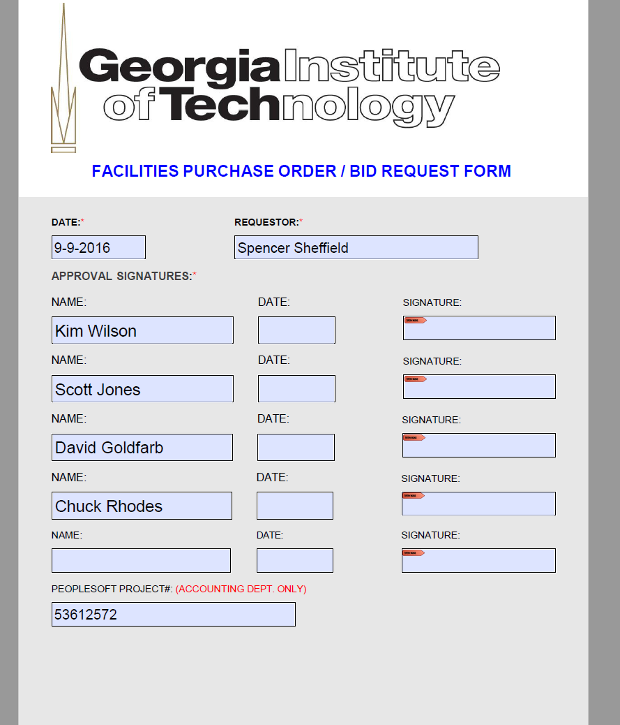
How do I use a p.o. at GT?
Issuing a P.O. is straight forward with the exception that it is a manual process and not put into ImageNow. The form is located on the Facilities Management Website under Standard Forms & Templates or can be accessed from the link below.
Include a proposal, invoice or other costing documentation as backup with this form.
Verify that any unit cost matches the Vendor’s recorded contract. Use any Vendor supplied work sheets for units that are part of the accepted contract.
After completion of the form and backup documentation, it is the PM’s responsibility to get D & C leadership’s signature. Once they have signed it then deliver it to Brenda Cochran, who will process it. If the amount of the PO Request is over $5K, she will get David and Chuck’s signature. Once that is complete Brenda puts it into Buzzmart. Buzzmart generates the Purchase Order.
Link to P.O. Form

Slide 5
Example

Slide 6
Pitfalls to be aware of
Unless you have access to Buzzmart the PM has no way of tracking the movement of the P.O.
The Vendor invoices through the AP invoice system (apinvoices@gatech.edu) not the GT Fac invoice system.
The contracting officer has to send the PM a PDF of the invoice for approval and then the contracting officer re-enters it into Buzzmart. Electronic stamping/signature is preferred.
A copy of the P.O. and invoices are not tracked in ImageNow. They are logged into AiM for tracking accounting. PM must keep an electronic copy of the P.O., change orders and all invoices related to the P.O. in the Project folder on the P: drive.

Slide 7
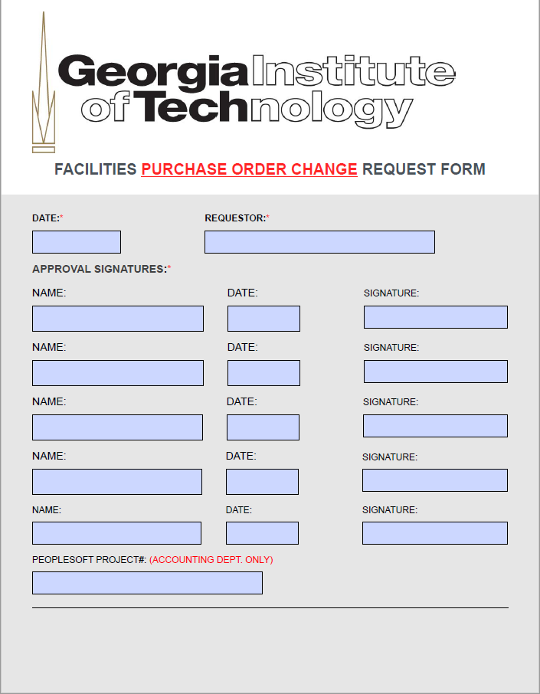
Change orders to Purchase Orders.
Issuing a change order to an active purchase order is the same process as issuing the original P.O.
Please be sure to use the PURCHASE ORDER CHANGE form.
See Link below for change order form.
Include back up (proposal letter or quote) for change order to be issued.
Link to P.O. Change Order Form

Slide 8
To recap.
Verify with contracting officer Vendor has current Contract or use this link for GT held P.O.
https://webapps.gatech.edu/cfeis/vendor_info/vendor_lookup_form.cfm
Link to look up SWC
http://doas.ga.gov/state-purchasing/statewide-contracts
Issuing a P.O. is straight forward. Use the forms on the forms website.
Issue change orders on the PURCHASE ORDER CHANGE form.
Look for emails from the contracting officer on approving invoices.

Slide 9
Other useful Information

